Slide 1
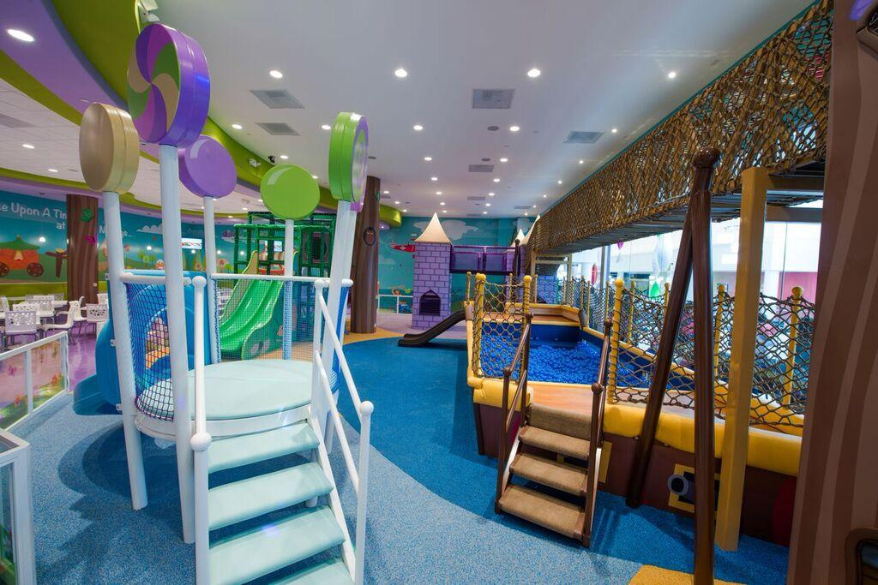
RECENT news and PRESS
Joey Parsi

Slide 2
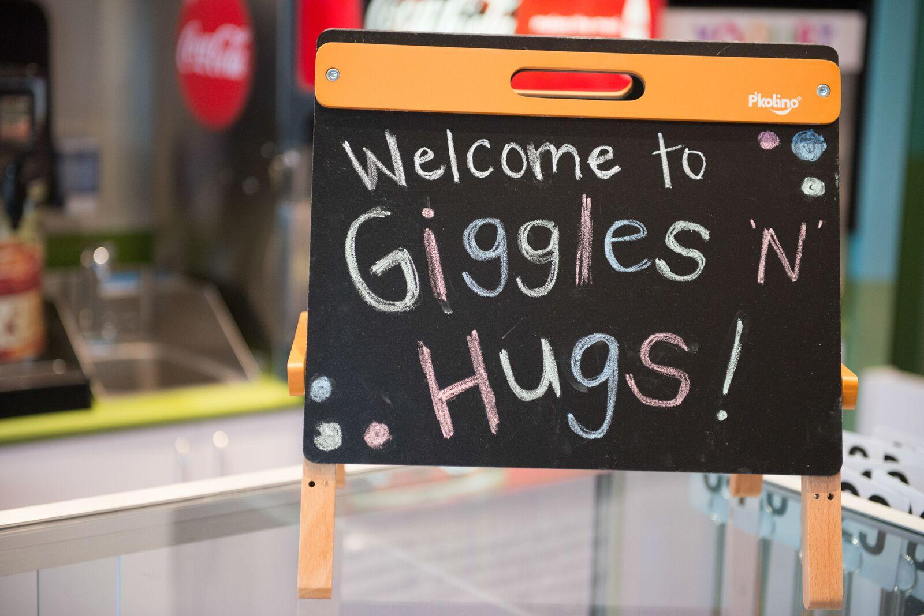

Slide 3
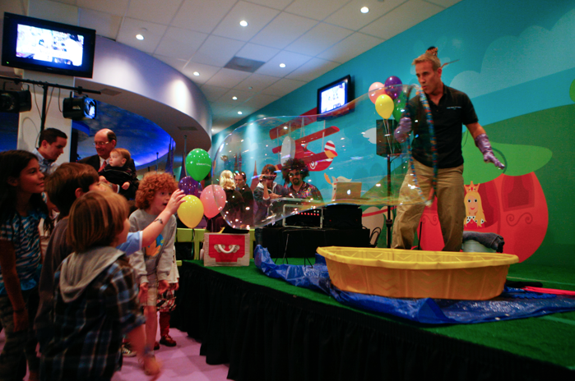

Slide 4
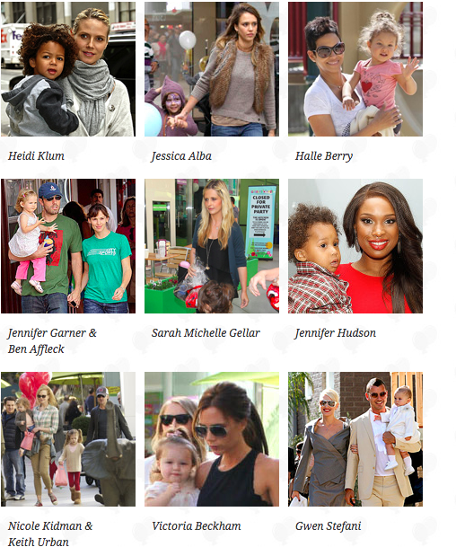
Celebrity Guests

Slide 5
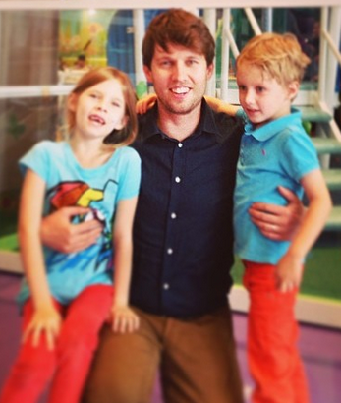
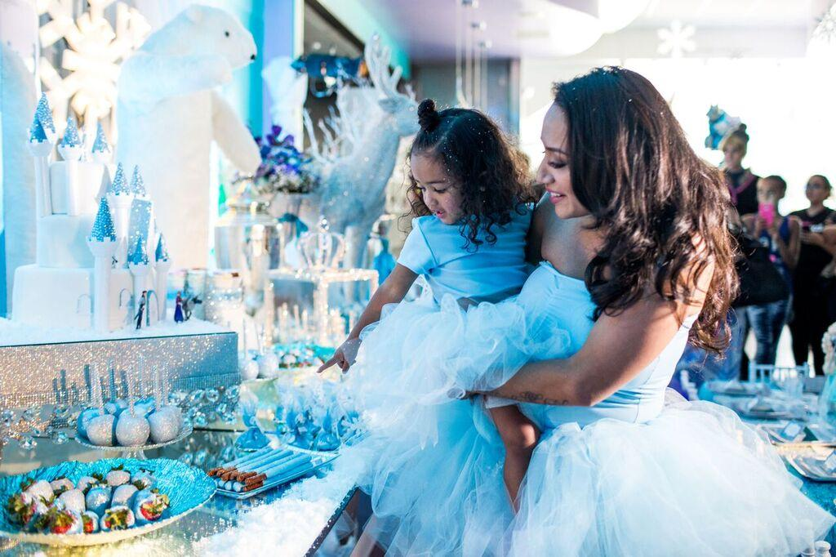
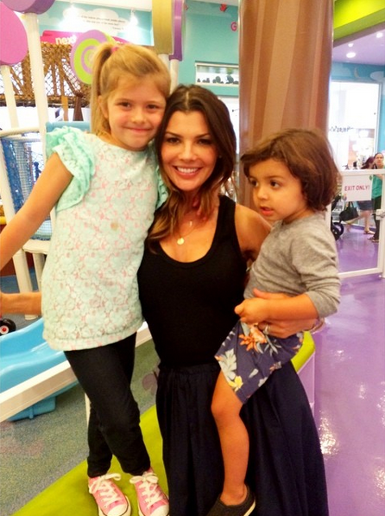
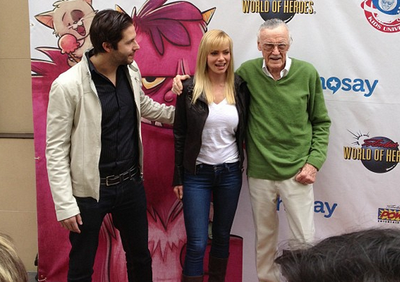
Recent Guests!

Slide 6
National Media Coverage

Slide 7
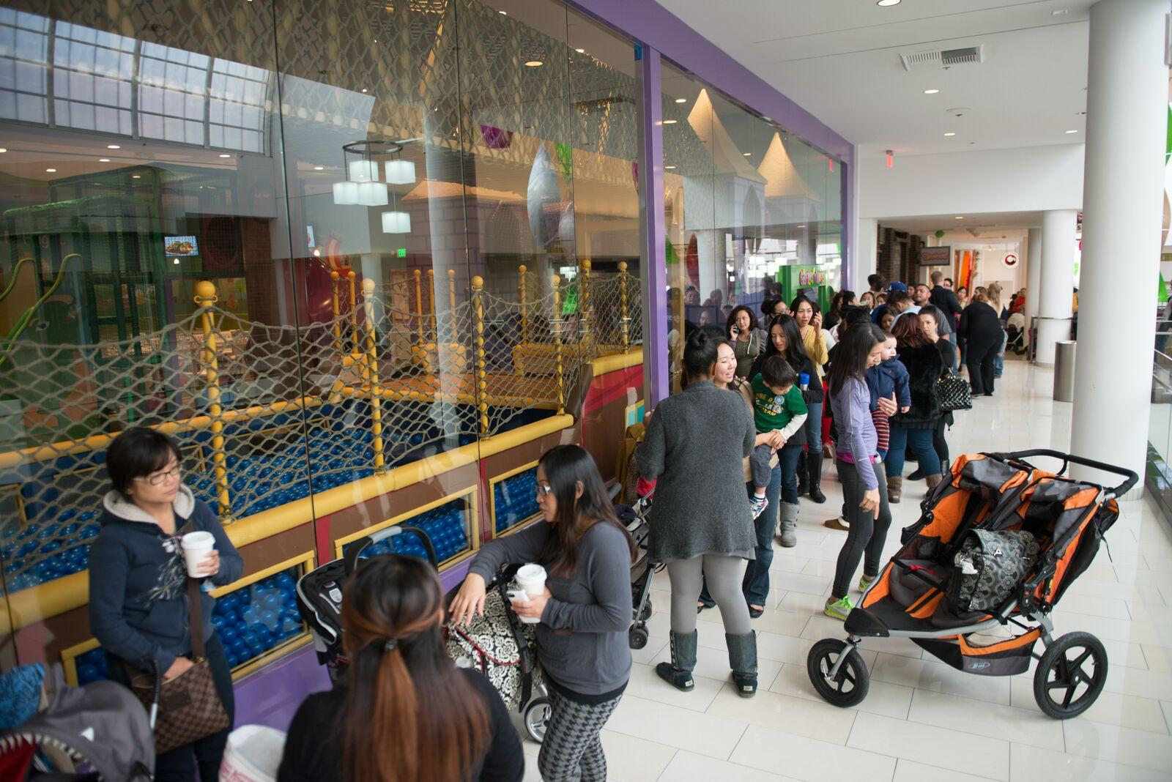

Slide 8
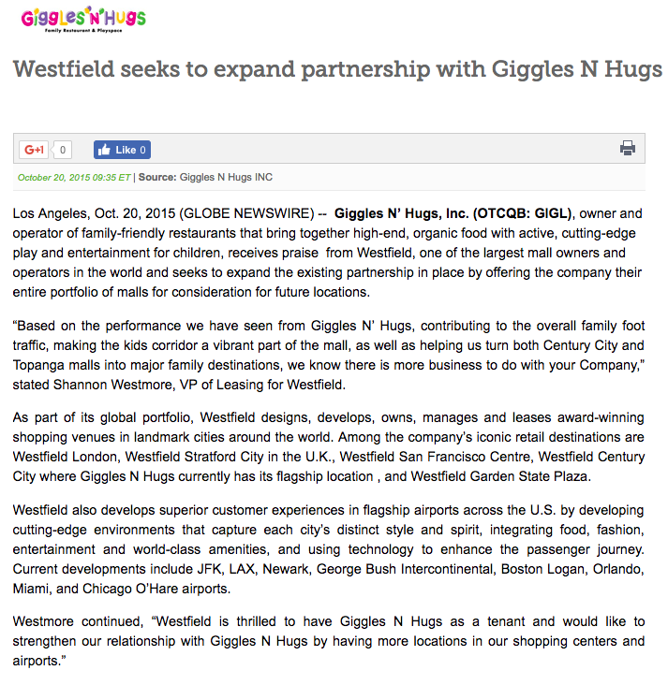

Slide 9
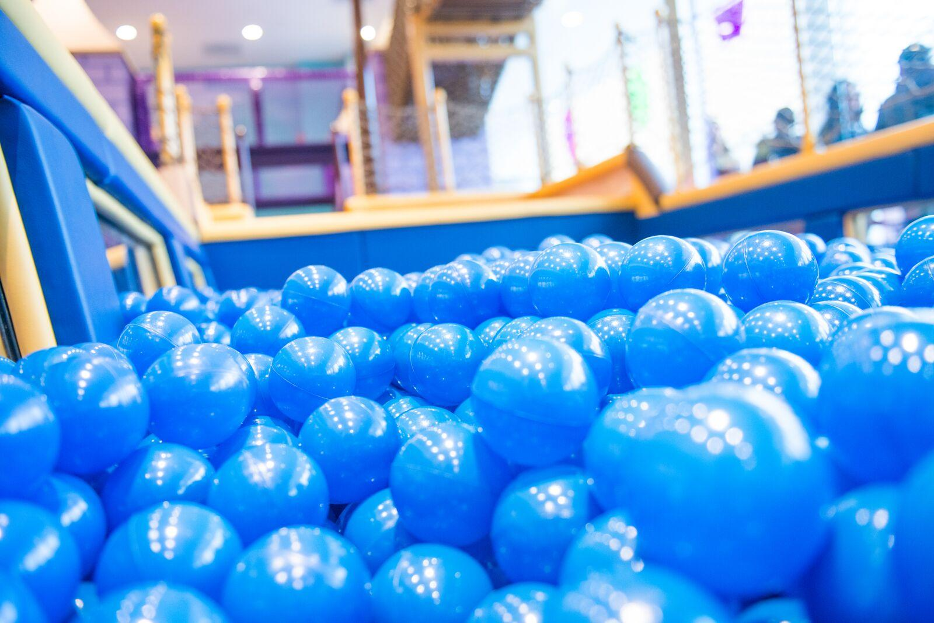

Slide 10
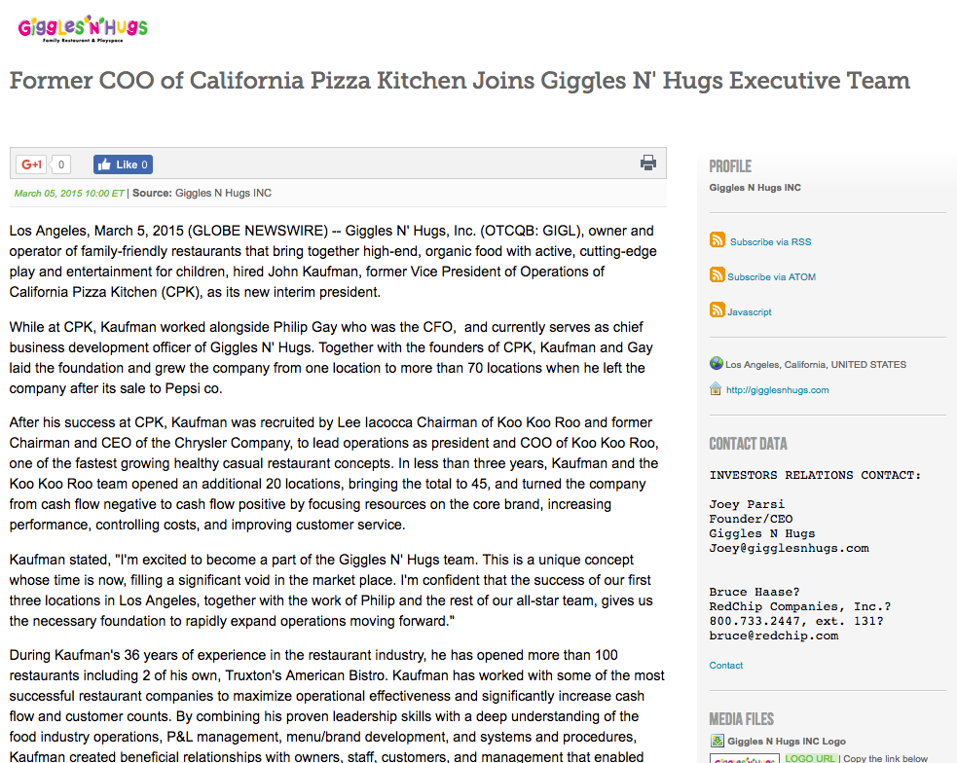

Slide 11
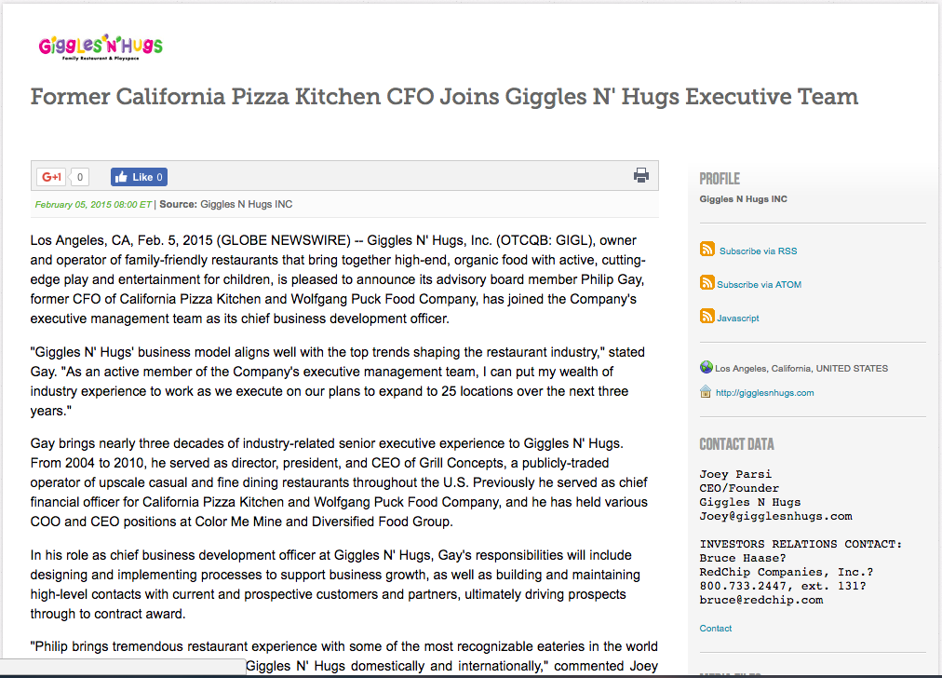

Slide 12
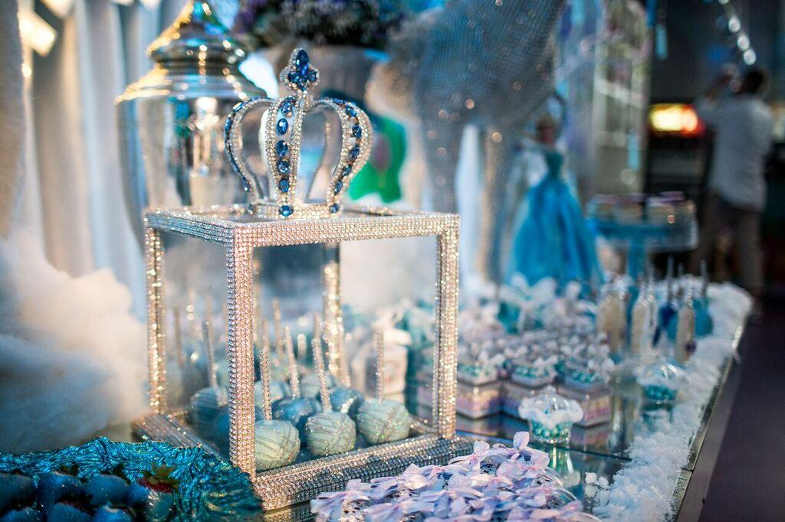

Slide 13
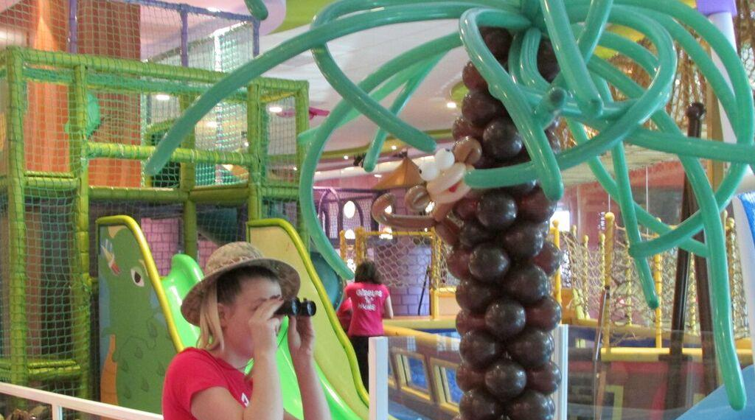
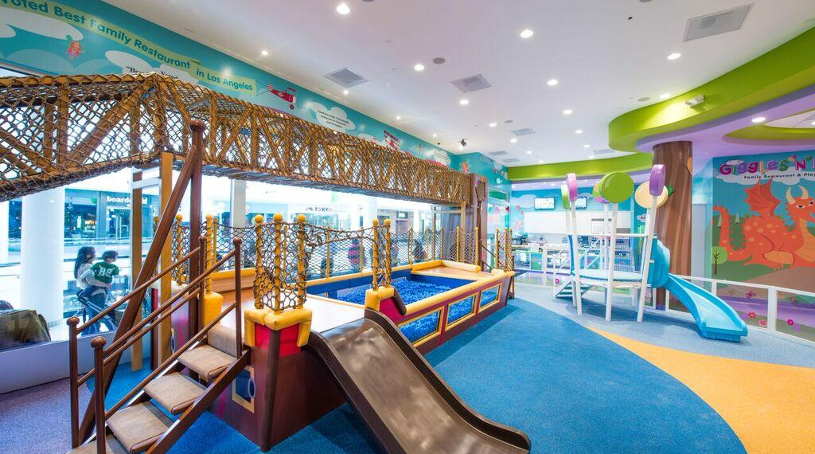
See why Giggles N’ Hugs was named LA’s #1 Birthday Party Destination by Nickelodeon!
Our “one-of-a-kind” birthday parties are filled with NONSTOP EXCITEMENT and FUN! - all set inside our dazzling 6,000-foot family restaurants and playspaces.
We take care of EVERY SINGLE DETAIL. Enjoy the day, knowing that our award-winning, professional staff is handling set up, clean up, and everything in between.

Slide 14
Corporate Video Overview

