Slide 1
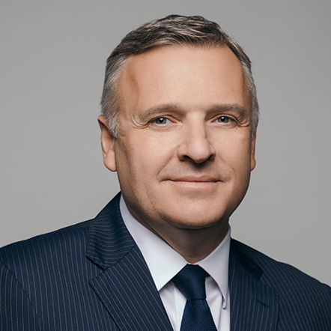
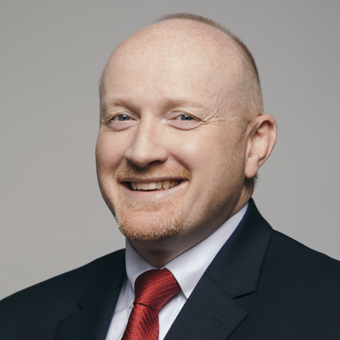
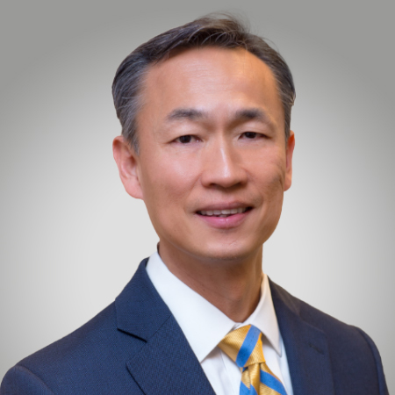
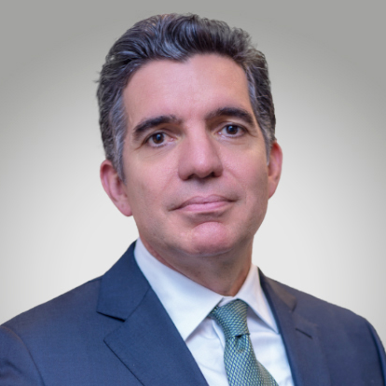
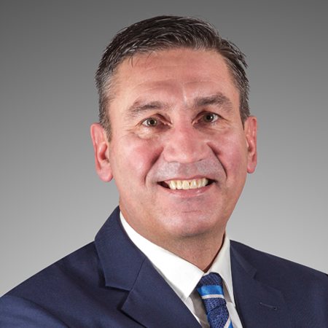
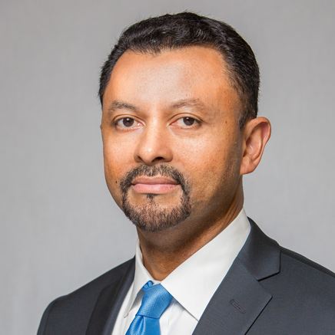
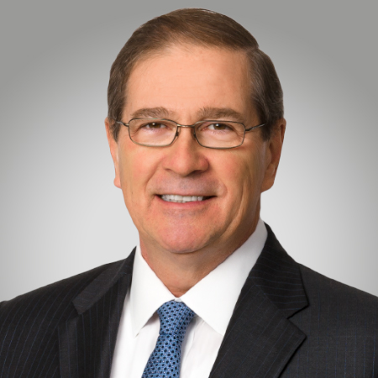
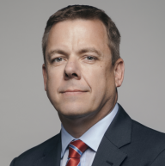
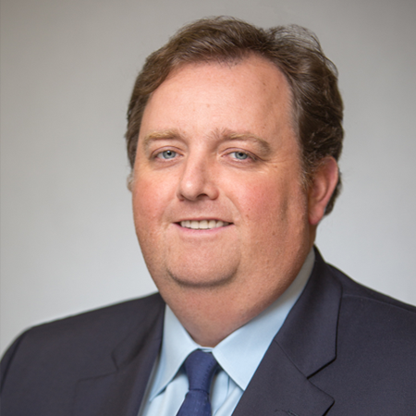
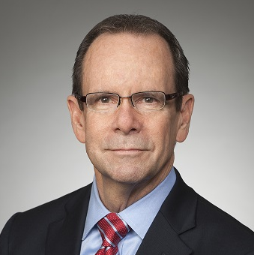
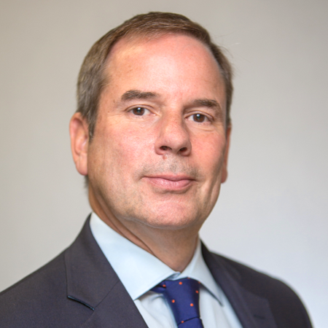
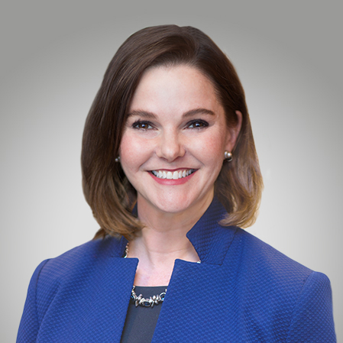
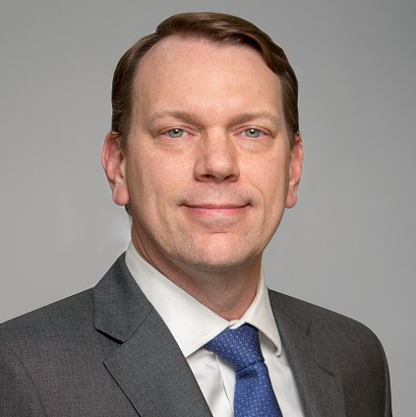
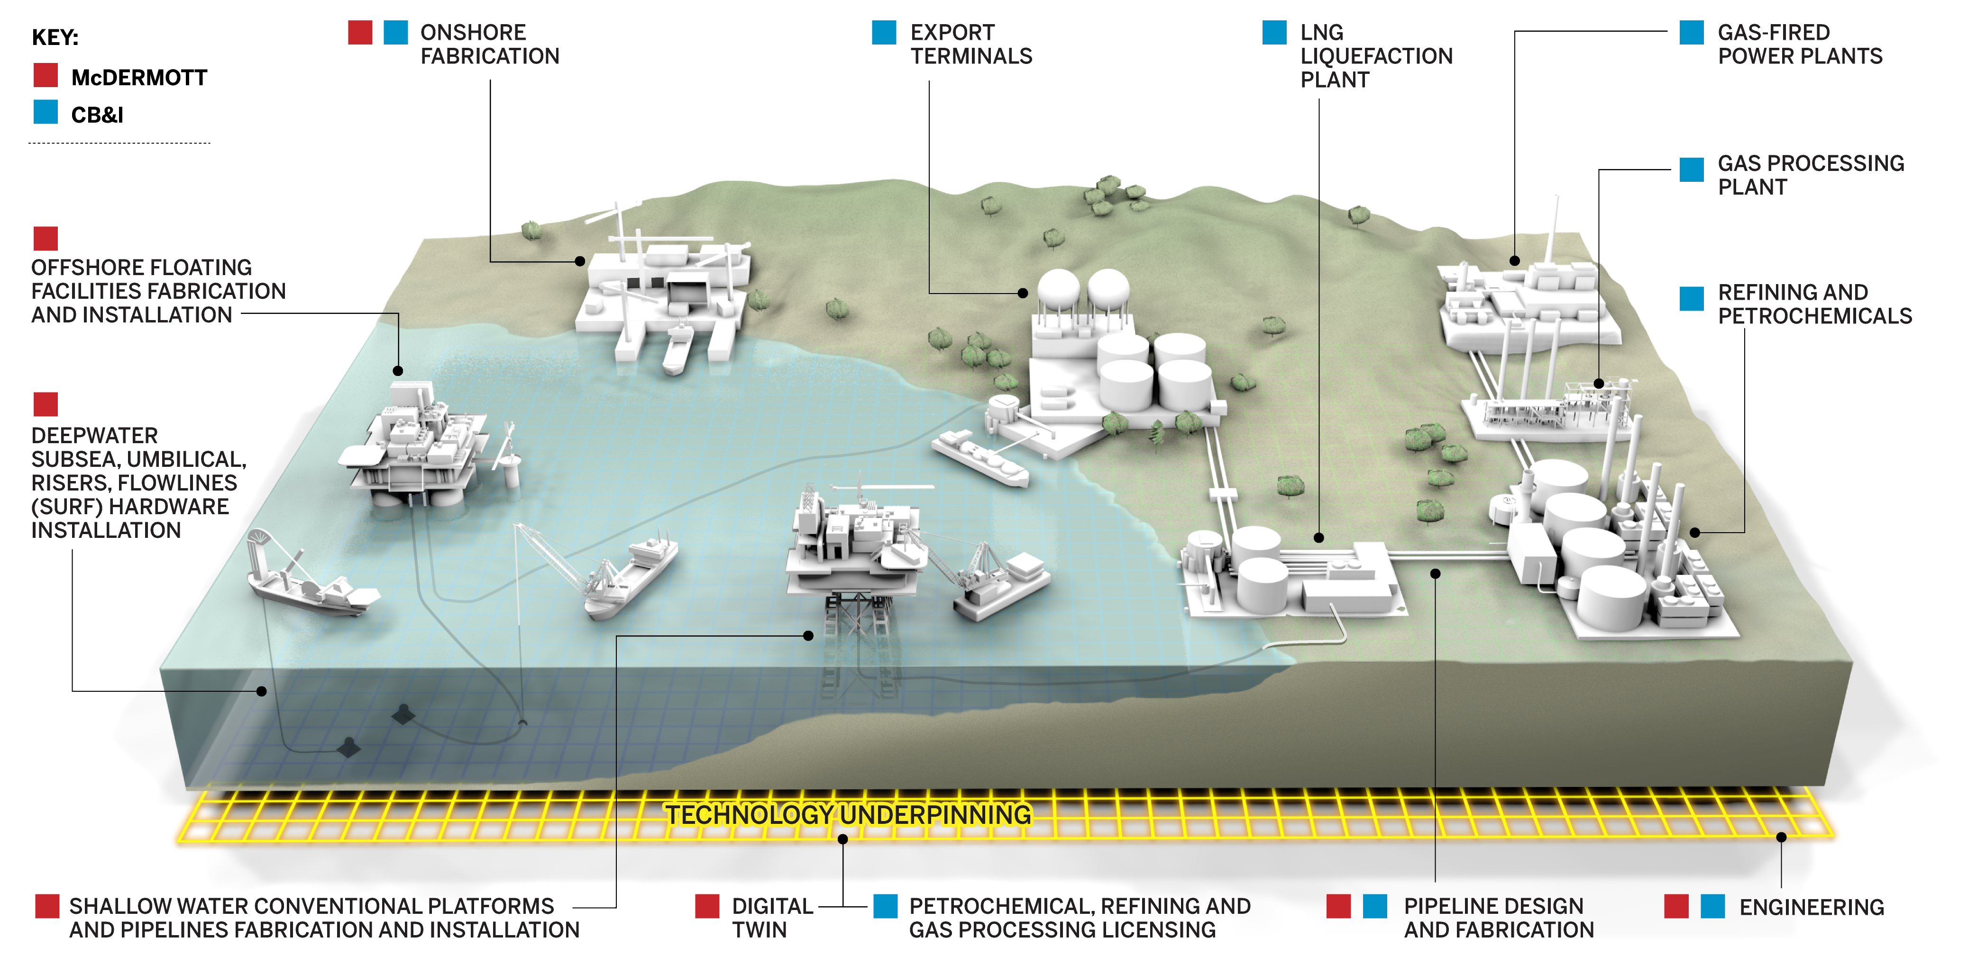
A Look Inside Our Future Together:
Building a leadership team to drive
near-term value and long-term growth
THE EXECUTIVE LEADERSHIP TEAM
Comprised of extraordinary talent from both McDermott and CB&I, as well as the wider energy industry, the global leadership team will include:
DAVID DICKSON
President & Chief Executive Officer
Nearly 30 years’ experience in the oilfield engineering and construction industry, holding management positions in market development, project management, engineering and construction
Oversees the strategic direction of McDermott, including responsibility for the company’s international growth
Previously spent 11 years with Technip S.A. and its subsidiaries, including as President of Technip U.S.A., Inc., with oversight for the company’s North American operations
STUART SPENCE
Chief Financial Officer
20+ years of financial and operational management experience
Responsible for financial and accounting operations, focused on sustainable, profitable growth and shareholder returns
Previously served in senior management roles at Halliburton and other oilfield services companies
RICHARD HEO
North, Central & South America
Seasoned executive with extensive sales and operations experience
Led CB&I’s Fabrication Services business
Previous leadership roles and responsibilities include technology sales and operational oversight for project and construction management, fabrication shops and specialty engineered products
TAREQ KAWASH
Europe, Africa, Russia & Caspian
Nearly 30 years of experience in the engineering and construction industry
Previously led international operations for CB&I’s Engineering & Construction business
Career includes business development, operational and project management roles in Europe, the Middle East and Africa
IAN PRESCOTT
Asia Pacific
28+ years of experience of extensive operational, marketing and business unit responsibilities
Previously VP, Asia at McDermott and member of the company’s Executive Committee
Previously held top leadership positions at SNC-Lavalin and Global Process Systems
LINH AUSTIN
Middle East & North Africa
20+ years of progressive experience in directing oil and gas projects, strategy, P&L and change management
Previously VP, Middle East and Caspian for McDermott after joining the company in 2015
Prior to joining McDermott, served as Senior Advisor to the leadership of ADMA-OPCO in Abu Dhabi
DANIEL MCCARTHY
Technology
40+ years of experience in the energy industry
Previously led CB&I’s Technology business
Leadership roles and responsibilities include process engineering and design, process licensing, global product marketing and management
BRIAN MCLAUGHLIN
Commercial
Experienced executive with international expertise in the oil and gas industry
Previously served as McDermott’s SVP, Commercial, and held multiple leadership roles since joining the company in 2006
Before joining McDermott, held roles with several companies throughout the Middle East and other countries
JONATHAN KENNEFICK
Project Execution & Delivery
20+ years of experience in offshore construction projects
Joined McDermott in 1992 and most recently served as SVP, Project Execution and Delivery
Experience leading projects both in deepwater and shallow water infrastructure
SCOTT MUNRO
Corporate Development
Extensive international management experience in the oil and gas industry
Previously responsible for the growth and development of McDermott’s business across the Americas, Europe and Africa
Experience at oil and gas companies in the UK, U.S., Canada, Brazil and France
STEVE ALLEN
Human Resources
25+ years of human resources experience
Leadership roles in compensation, benefits, talent acquisition, talent management and real estate management
Previously led HR functions at both Technip USA and Duke Energy
JOHN FREEMAN
Legal
30+ years of legal experience both in the private and public sector
Before joining McDermott, served as Special Advisor for the Integration of Technip and FMC
Previously responsible for worldwide leadership of all legal and compliance matters at Technip, based in Paris
GENTRY BRANN
Communications
25+ years’ experience in strategic communications, marketing, public affairs and investor relations
Led global internal and external communications at CB&I
Previously held communications and marketing leadership roles in engineering and construction, government, and advertising and public relations firms
We are Driving Energy Forward with Integrated End-to-End Solutions
TONY BROWN
Integration
Accomplished executive who has served in senior legal, sales and strategy roles
Previously led Strategy for McDermott and is currently integration planning lead for McDermott’s combination with CB&I
Career with McDermott includes leading global initiatives and strengthening relationships with customers

