Slide 1
The Leading Platform Cooperative for Cities
Rob Monster, CEO
See the World through Local Eyes!

Slide 2
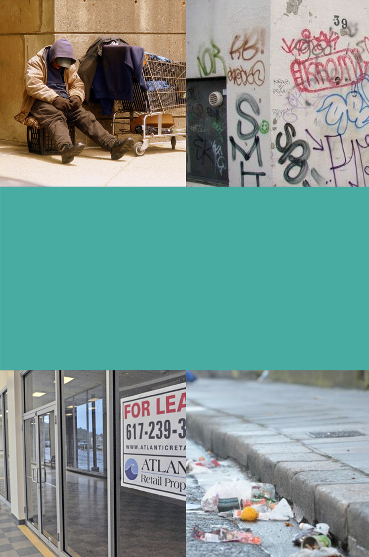
The Problem
Cities have lost control of their Digital Brand
Only 6% of visitors to a city will use a city visitor website or app
50% of digital media is consumed on apps. Most cities don’t have one.
Pressure on merchants from Winner-Take-All
2% average annual decline in local retail sales
Up to 40% commissions paid by hotel operators to market-makers
Sharing economy is causing a new Wild-West
Regulation, taxation, and enforcement of sharing economy is difficult
In Barcelona, 30% of all apartments are now Short Term Rentals!
Cities are experiencing unprecedented pressure in the Digital Age

Slide 3
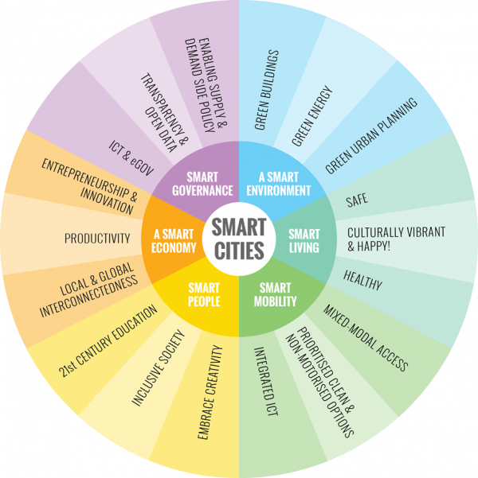
The Goal for Cities
A thriving, sovereign and sustainable local economy where:
People are able to live, work and spend locally
Residents co-create improved Quality of Life
Sharing Economy that works for everyone

Slide 4
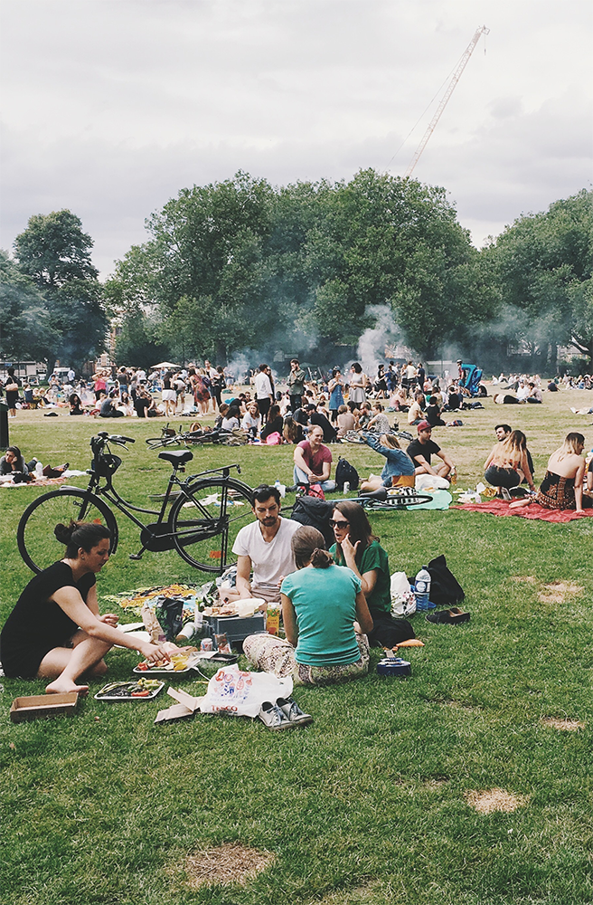
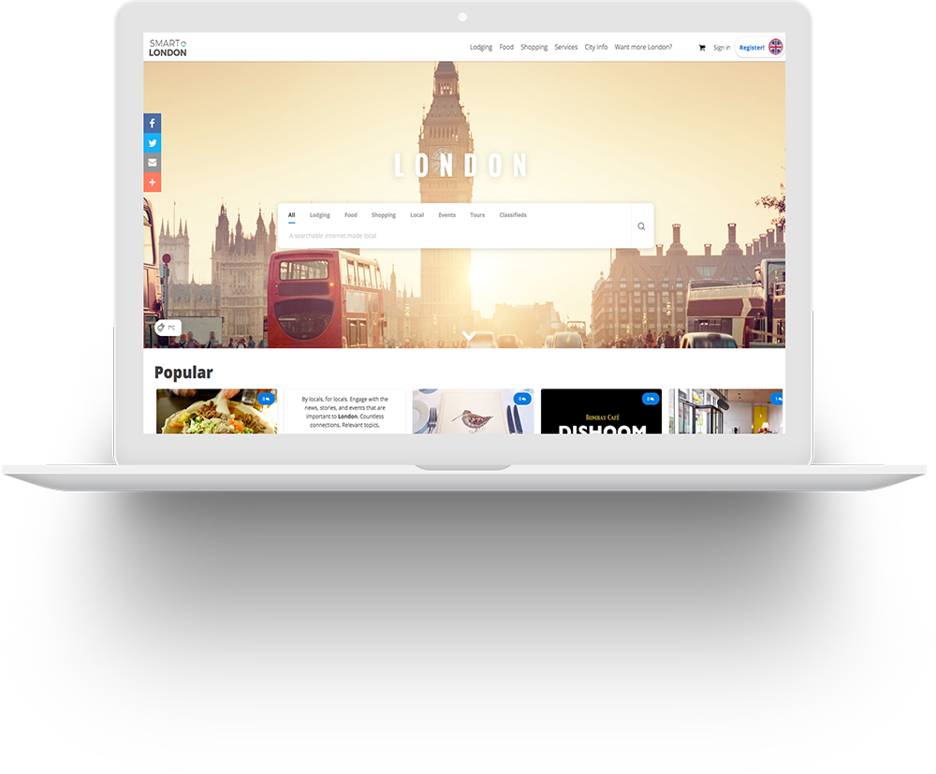
The DigitalTown Solution
The result:
Money stays in the local economy
Residents are engaged 24/7 digitally
Visitors can see the world through local eyes
Every city becomes its own locally owned
all branded in the identity of the city on web and mobile.

Slide 5
How DigitalTown makes it easy to keep money in the local economy

Slide 6
1. Smart Search
Local First
Highly accurate local search
Transactional Search
Not just search but transactional search
Smart
Intelligently address public and private sector needs
The City becomes its own Google.
Only better!

Slide 7
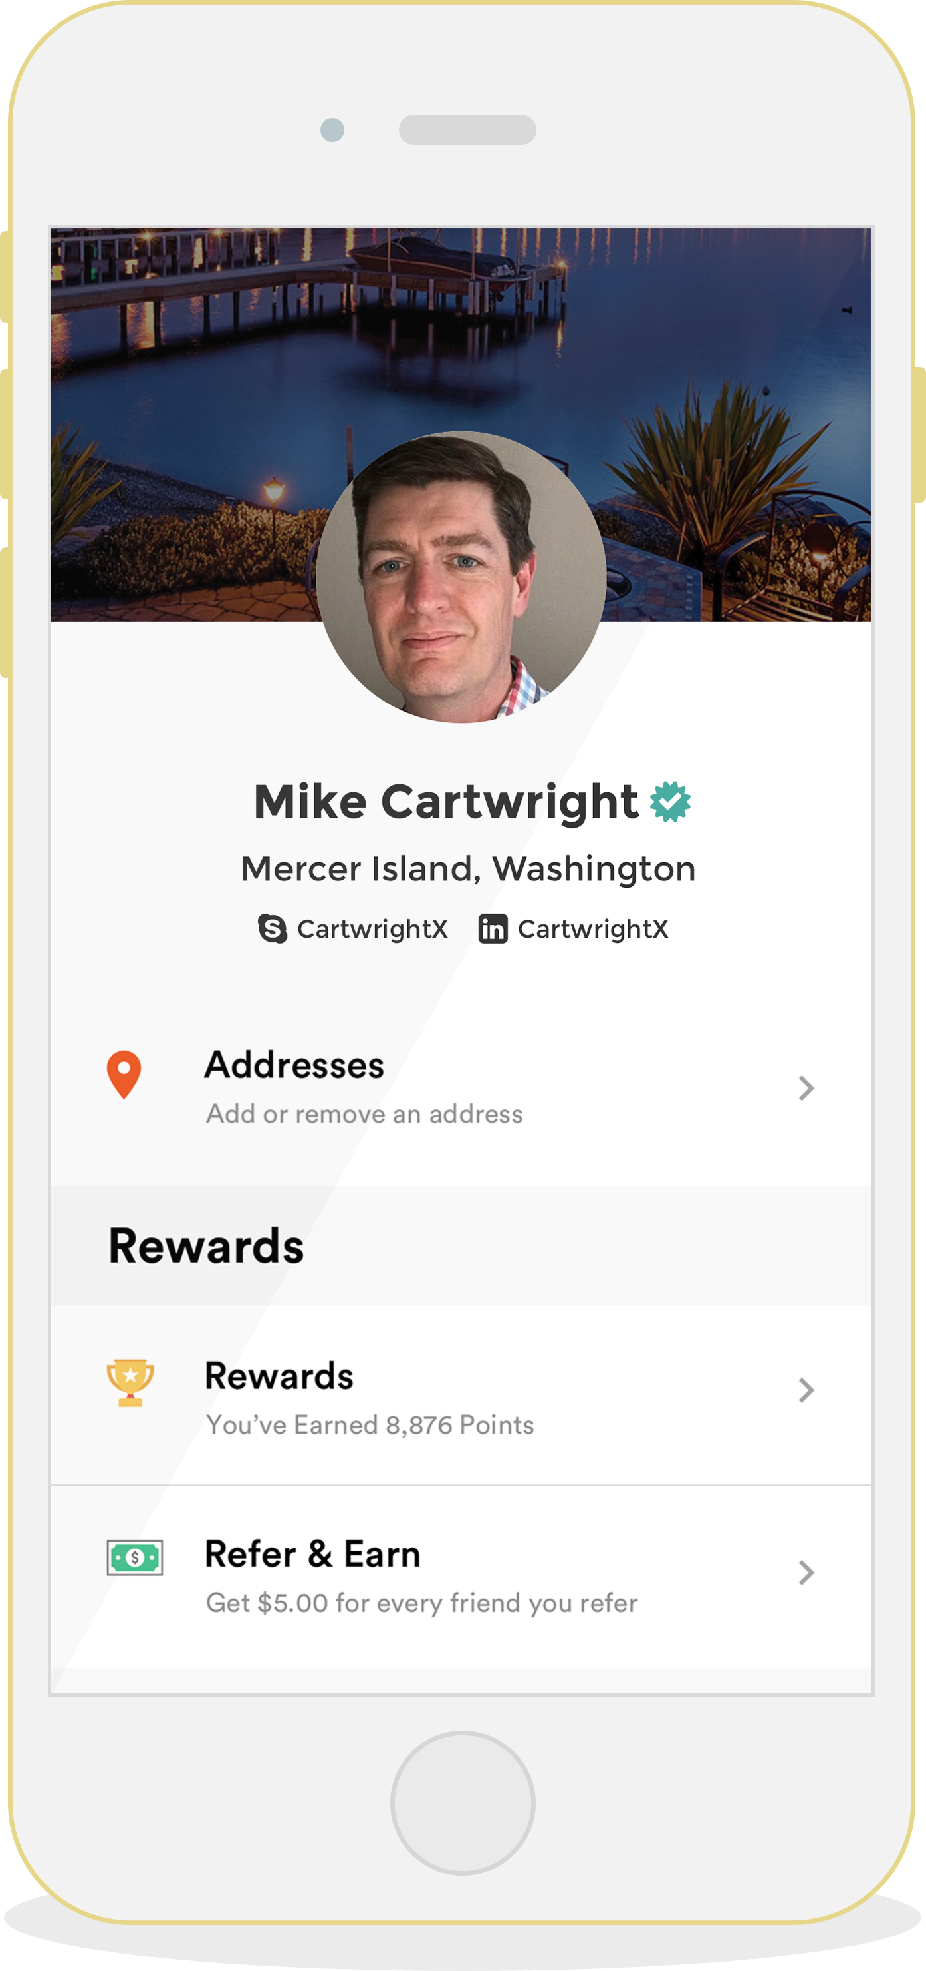
2. Smart Wallet
Portable Verified Identity for every Legal Resident
Locally or Centrally verified
Regulatory compliance for management of personal data
Preferences
Personal Preferences
Location and Itinerary
Payments
Payment Sources
Locally compliant disbursement of funds
Single Sign-on for the World

Slide 8
3. Smart Web
Intuitive
A web that makes sense: Austin.Law, London.Menu
Domain extensions bundled with turn-key tools
Geographies .CITY, .BAYERN, .BOSTON
.DUBAI, .LONDON, .MELBOURNE,
.MIAMI, .SYDNEY, .TOKYO, .WIEN
Verticals
.ART, .FASHION, .LAW, .LOAN,
.MENU, .SHOP, .STORAGE, .WEDDING, .WORK, etc.
Personalized
Personal Dietary Preferences, e.g. Smart.Menu
Location and Itinerary, e.g. Smart.London
Secure
Integrated Smart Wallet lets user control which publisher has access to what data!
A Web that Works

Slide 9
4. Smart Commerce
Circular Economy
Local First for Retail, Services, Dining and Lodging
Used and New Goods and Services in one view
Sustainable Economy
Any merchant can have a Digital Storefront for free
Transaction Fees fund Smart City Innovation
Safer Community
Transactions between verified buyers and sellers
Sharing Economy benefits all stakeholders
Buy Local. Buy Direct.

Slide 10
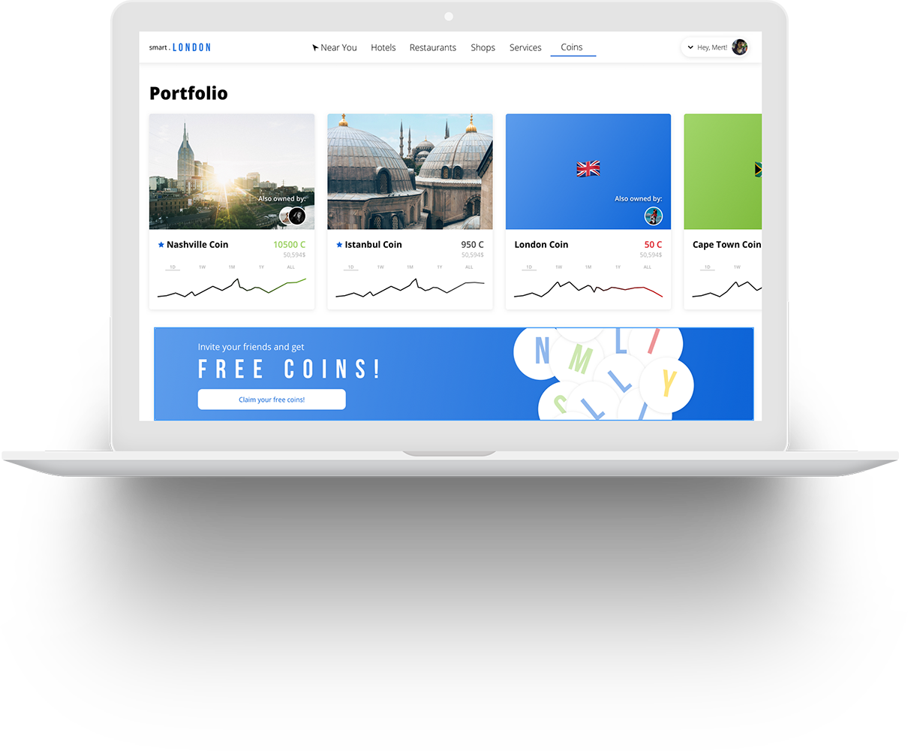
5. Blockchain for Distributed Ownership
One CityShare reserved for every Citizen
Legal resident claim their free share during claim period
Unclaimed shares distributed through auction
Each unique share has ongoing value
Value of each share increases through platform adoption
Optional dividend distributions of shared gains
Liquidity through frictionless trading
Coin owners may buy and sell their shares
Tradable on any public Blockchain exchange
Shared Ownership. Shared Outcome.

Slide 11
Vertical Solutions
For Local Commerce

Slide 12
Local Commerce in the Digital Age
Superior Economic Model for Smart Cities
Lower Commission than national benchmark competitors
Local taxes are collected and held at time of purchase
Leverage Legacy Institutions
Municipality as core partner
Trade Associations, Chambers of Commerce, CVB/DMO
Equipping Legacy Institutions for relevance in the Digital Age

Slide 13
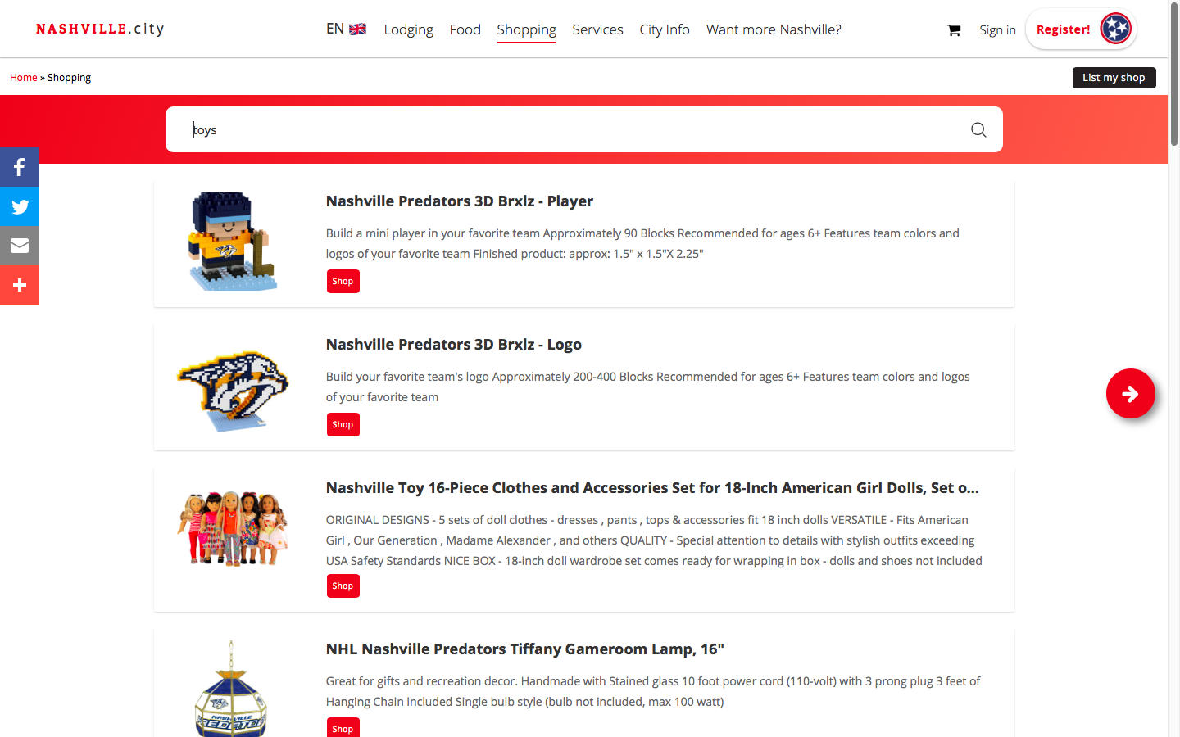
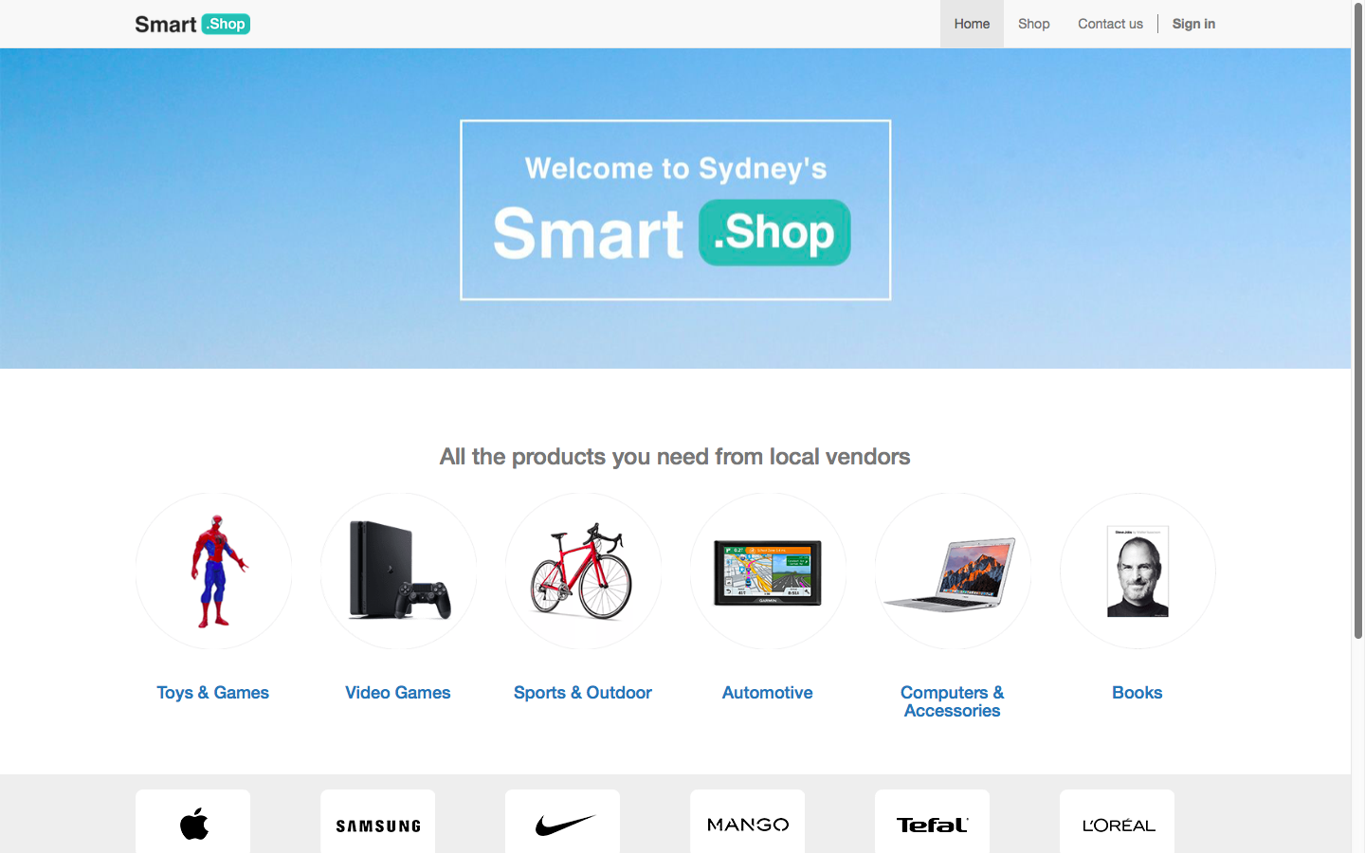
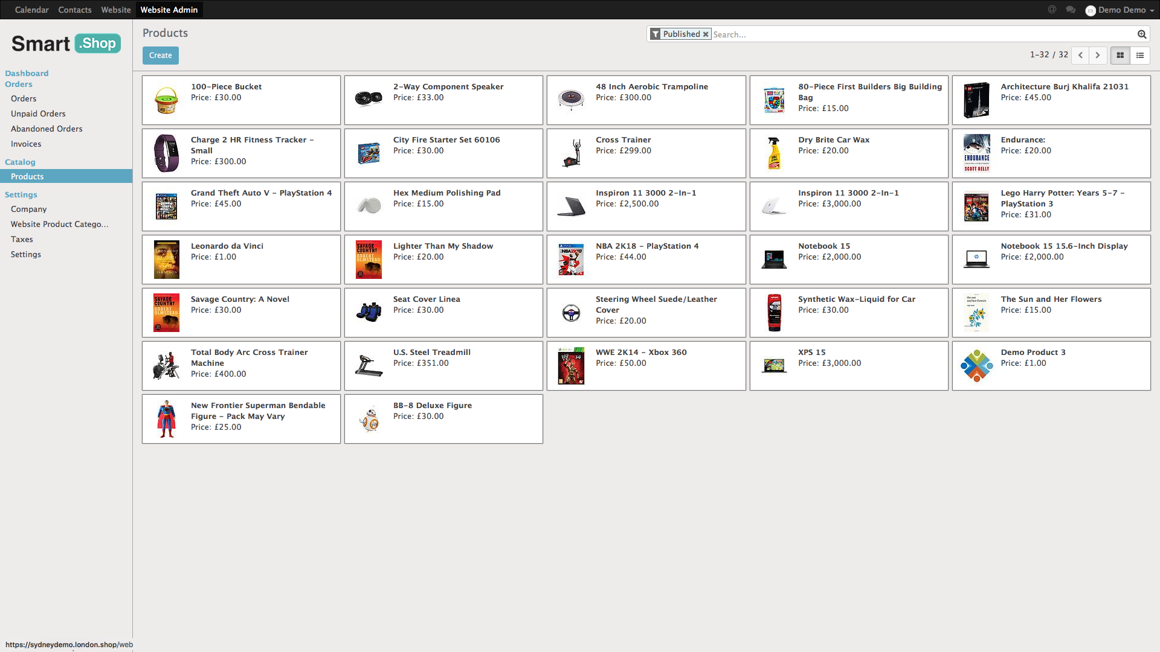
Retail
Any retailer can sell online today and have their products discovered in the local city search or in a local shopping directory powered by .SHOP.
No setup fee. No service fee.
8% commission on actual sales
Notes:
Add config page

Slide 14
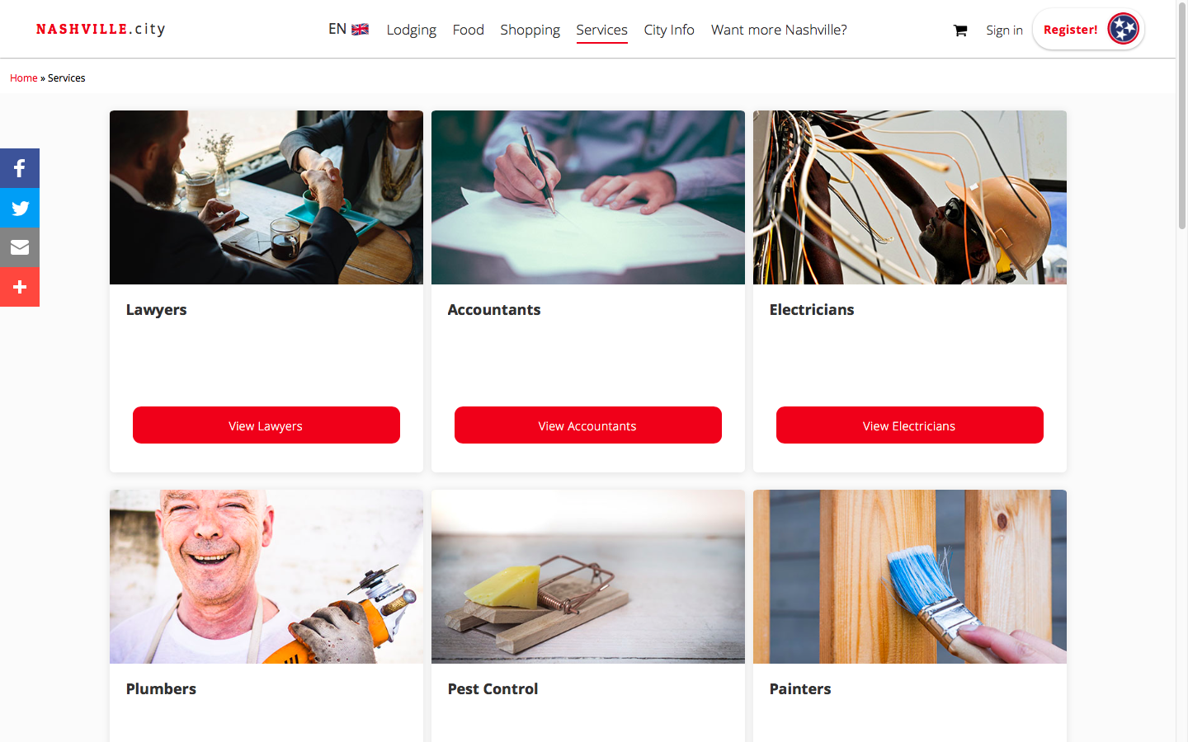
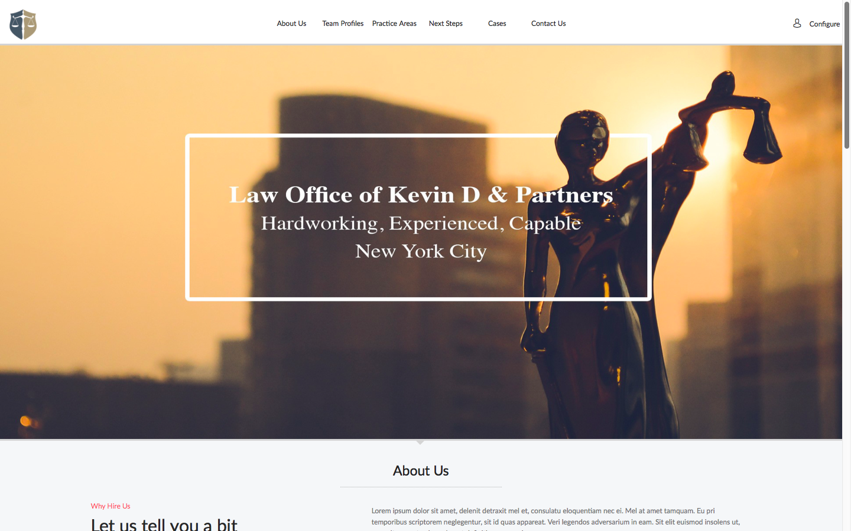
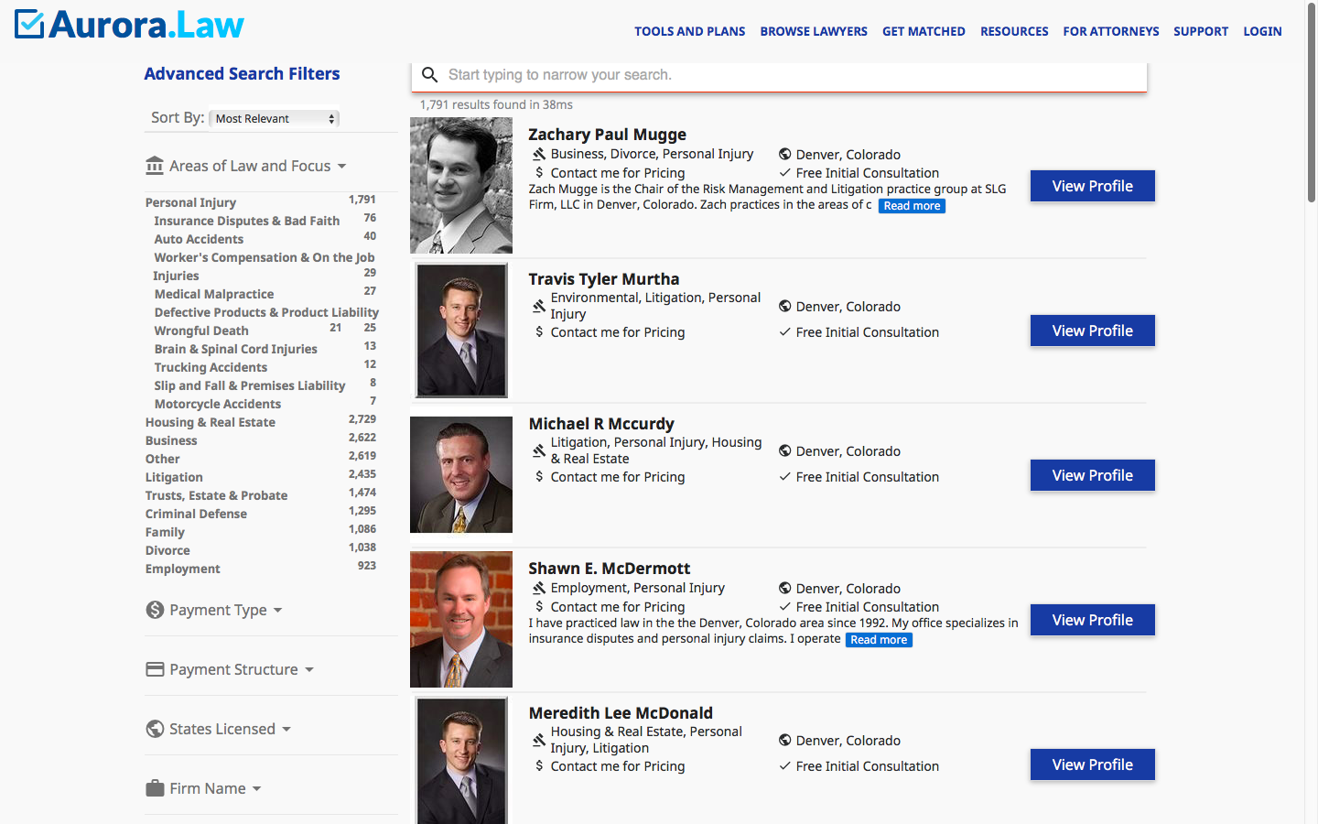
Services
Any service provide can sell online today and have their services discovered in the local city search or in service provider directory like City.Law
No setup fee. No service fee.
8% commission on sales.

Slide 15
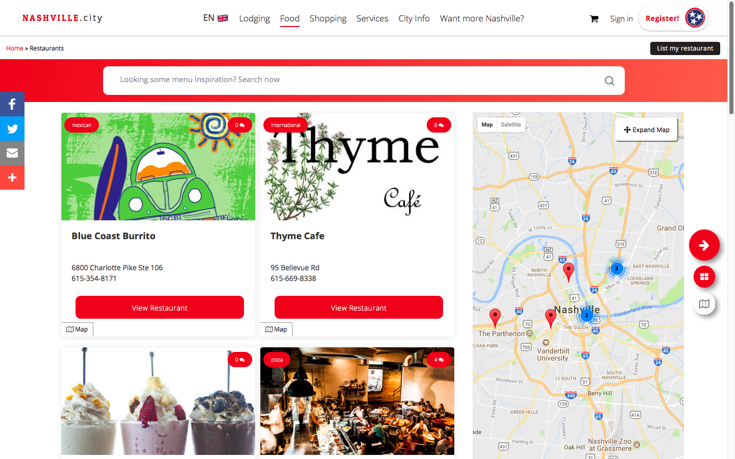
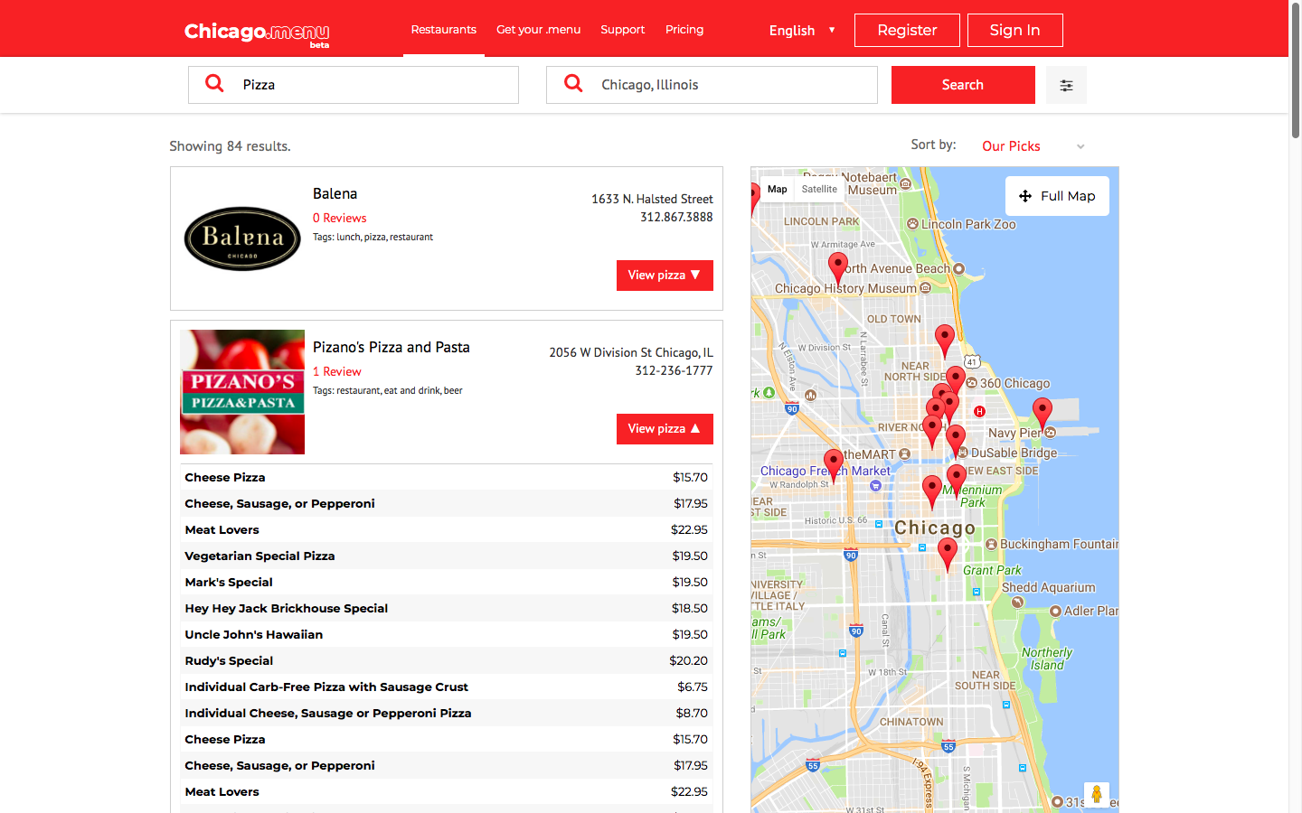
Dining
Any restaurant or caterer can interactive their menu online today and be discovered in the local city search or the local dining directory using .MENU.
No setup fee. No service fee.
$8% commission for online orders.
$1 per cover for in-restaurant table booking.

Slide 16
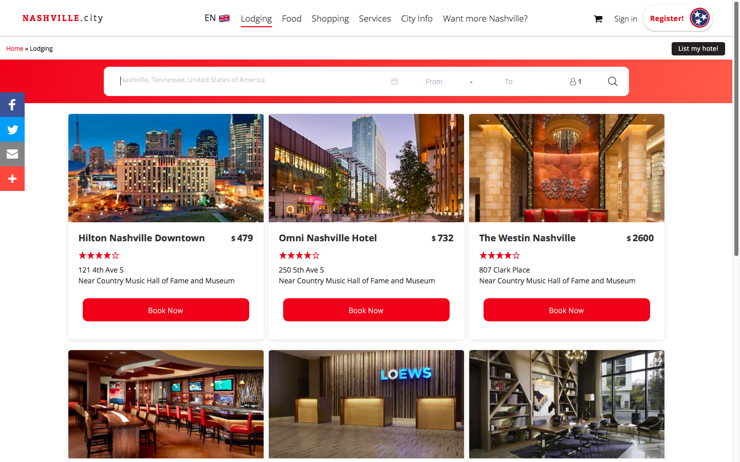
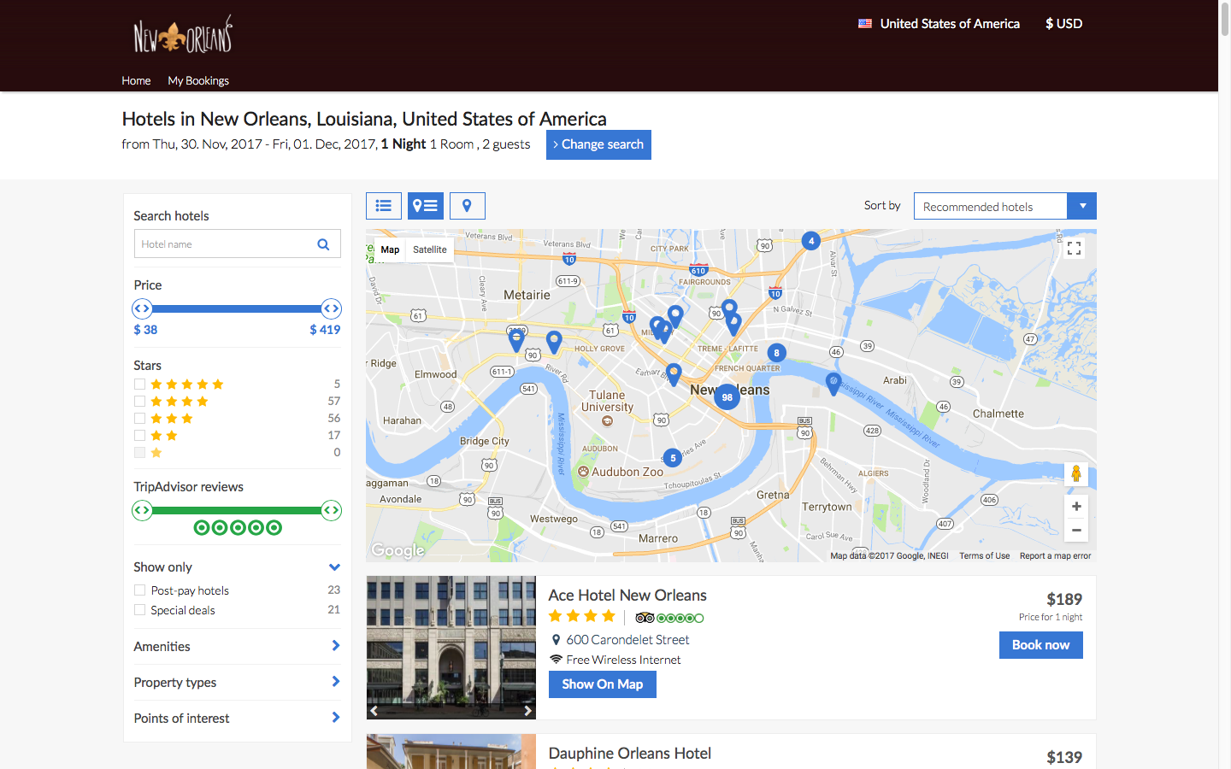
Lodging
Any hotel, hostel or B&B can sell online today and have their rooms discovered in the local city search or through a network of more than 350 affiliates, who have booked more than $3 million USD in lodging so far in 2017.
No setup fee. No service fee.
Commission rate of 12% for any private lodging listing

Slide 17
Global Traction
Digital Presence in 23,000 cities
Site live in more than 10,000 cities
1st Municipal Deployments going live

Slide 18
Deployment Timeline for Cities
Stakeholder Engagement Timeline: 1 month
Merchant Onboarding Timeline: 1-3 months
Community Engagement ongoing
1
2
3
4
5
Platform Development Timeline: 1-3 months
Resident Onboarding Timeline: 1-3 months

Slide 19
Rob Monster, CEO
rob@digitaltown.com
Tel: +1-425-295-4564
Local First through Smart Search, Smart Wallet, Smart Web and Smart Commerce
Shared Ownership through Platform Cooperativism and Blockchain
Happy Citizens in Thriving, Sustainable, Sovereign, Smart, Local Economies

