Slide 1
Q4 2015 Investor Presentation
February 26, 2016
DRAFT – 2.24.16 @ 4:30 PM CT

Slide 2
Safe Harbor Statement
This presentation contains "forward-looking statements" within the meaning of the U.S. Private Securities Litigation Reform Act of 1995. Such statements give our projections or forecasts of future events and are based on our current expectations and assumptions regarding our business, the economy and other future conditions; they do not relate strictly to historical or current facts. In particular, these include statements relating to future actions, business plans, objectives and prospects, future operating or financial performance, or references to guidance. In addition, statements in this presentation regarding our intention to repurchase shares of our common stock from time to time under the share repurchase program, the intended use of any repurchased shares and the source of funding are forward-looking statements subject to uncertainties. Factors or events that could cause actual results to differ may emerge from time to time and it is not possible for us to predict all of them. Should known or unknown risks or uncertainties materialize, or should underlying assumptions prove inaccurate, actual results could differ materially from past results and those anticipated, estimated or projected. We caution you therefore against relying on any of these forward-looking statements. Factors that could cause or contribute to such differences, include, but are not limited to: negative or reduced growth rate of spending on Medicaid/Medicare; variations in our results of operations; our ability to execute our business plans or growth strategy; the risk that guidance may not be achieved; unfavorable outcomes in legal proceedings, including contract award protests; our ability to continue to secure contracts or favorable contract terms through the competitive bidding process; the market price of our common stock; changes in the U.S. healthcare environment or healthcare financing system and steps we take in anticipation of such changes; pending or threatened litigation; development and implementation of new product solutions or new process improvements; regulatory, budgetary or political actions that affect procurement practices; our ability to retain customers or the loss of one or more major customers; the unexpected reduction in scope or termination of a significant contract; customer dissatisfaction, our non-compliance with contractual provisions or regulatory requirements, or failure to meet performance standards triggering significant costs or liabilities under our contracts; the cancellation or delay of procurements or contract implementation due to protests or challenges to government awards; emergence of new competitors or competitors’ introduction of new or superior products or services; our failure to comply with laws and regulations governing health data or to protect such data from theft and misuse; our ability to maintain effective information and technology systems and networks, and to protect them damage, interruption or breach; our reliance on subcontractors, vendors or other third party providers and sources to perform services; restrictions on bidding or performing certain work due to perceived conflicts of interests; unanticipated changes in our effective tax rates; a failure to protect intellectual property rights, confidential and proprietary information, or confidential or proprietary information of others in our possession, despite our efforts; negative results of government or customer reviews, audits or investigations; our cash flows from operations, available cash and ability to generate sufficient cash to cover our interest and principal payments under our credit facility or to borrow or use credit; the continuation of our share repurchase program; the nature of investment and acquisition opportunities presented to us; and other factors, risks and uncertainties identified in our most recent Annual Report on Form 10-K and subsequent filings with the SEC, which are available at www.hms.com under the "Investor Relations" tab and at www.sec.gov. Any forward-looking statements are made as of the date of this presentation. Except as may be required by law, we disclaim any obligation to publicly update forward-looking statements, whether as a result of new information, future events or otherwise.
HMSY Q4 2015 Investor Presentation / February 26, 2016

Slide 3
Presentation Outline
HMSY Q4 2015 Investor Presentation / February 26, 2016

Slide 4
4Q and Full Year 2015 Financial Results
Financial Performance Highlights
Adjusted EPS of $0.19 per diluted share¹ in 4Q
Revenue, excluding Medicare RAC, of $118.8 million was 8.6% higher than the prior year 4Q / Full year growth was 7.7%
  Record quarterly commercial revenue was up 29.9% YOY; 12.5% higher than the prior quarter; and up 18.8% for the full year
  State government revenue was down 7.1% YOY and flat compared to both the prior quarter and the prior full year
  Medicare RAC revenue was $9.7 million for the quarter, compared to $4.6 million in the prior quarter and $2.8 million in the prior year fourth quarter
Payment Integrity revenue, excluding Medicare RAC, increased by 14.0% YOY
Medicaid Coordination of Benefits revenue increased by 6.7% YOY
The effective tax rate was 32.2% for the quarter and 38.4% for the full year
¹ Adjusted EPS is a non-GAAP measure. Adjusted EPS in the fourth quarter included an after tax benefit of $0.7 million or $0.01 per diluted share, related state apportionments and permanent differences, partially offset by a $1.4 million or $0.01 per diluted share expense related to disputes involving PCG
HMSY Q4 2015 Investor Presentation / February 26, 2016

Slide 5
4Q and Full Year 2015 Financial Results
Condensed Consolidated Statements of Income
($ in thousands, except per share amounts)
HMSY Q4 2015 Investor Presentation / February 26, 2016

Slide 6
4Q and Full Year 2015 Financial Results
Market and Product Revenue
($ in millions)
HMSY Q4 2015 Investor Presentation / February 26, 2016

Slide 7
Commercial Health Plan Growth
4
Commercial Health Plan Customer Profile
Approximately 250 health plans nationally
85+ million unique commercial lives under contract
[18] of the top 25 health plans nationally (by revenue) are HMS customers
All of the top 10 national and regional Medicaid managed care plans are HMS customers
Our top 10 customers accounted for approximately 60% of 2015 commercial health plan revenue
~75% of existing commercial health plan revenue is Medicaid related and the remaining ~25% is Medicare Advantage and at-risk commercial
Health Plan Consolidation Has Generally Been a Net Positive for HMS
Data as of December 31, 2015
HMSY Q4 2015 Investor Presentation / February 26, 2016

Slide 8
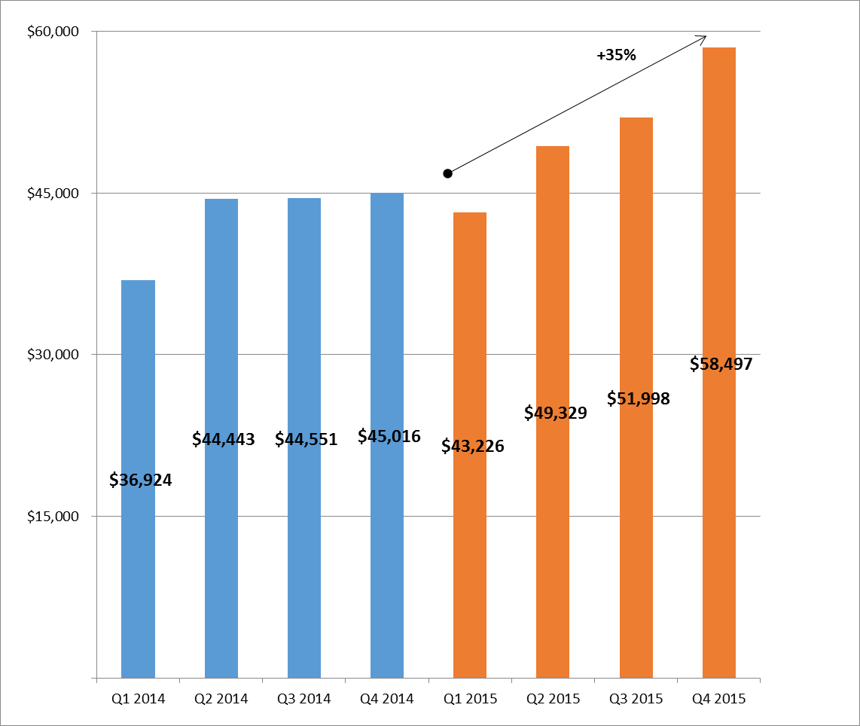
Commercial Health Plan Growth
Record 4Q Commercial Health Plan Revenue
Total Commercial Revenue for 2015 Was Up 18.8% Compared to the Prior Year¹
($ in thousands)
¹ Full year 2015 Commercial Health Plan revenue was $203.1 million, compared
to $170.9 million for the prior year
HMSY Q4 2015 Investor Presentation / February 26, 2016

Slide 9
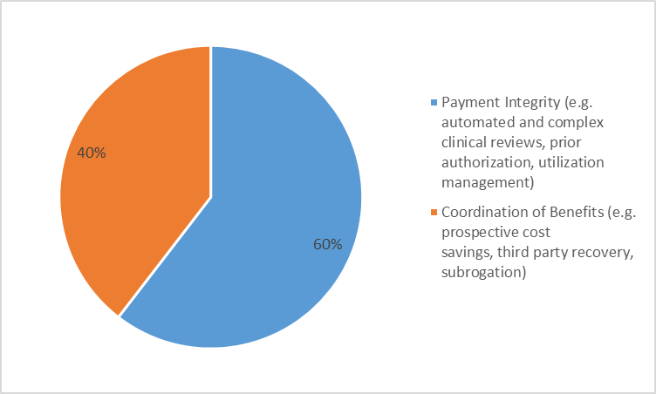
Commercial Health Plan Growth
4Q’15 Commercial Health Plan Growth
6
490,000 new lives added to commercial base
Additional products sold to current commercial customers covering approximately 5.0 million lives¹
¹ In some instances both COB and PI providers were sold to the same customer life, but such sales are only counted once for purposes of this calculation.
Note: Data as of December 31, 2015
HMSY Q4 2015 Investor Presentation / February 26, 2016

Slide 10
Commercial Health Plan Growth
Overview of 2015 Commercial Health Plan Sales
12 new managed care health plan customer sales closed during 2015
Over 90 new employer customer sales closed during 2015
Roughly half of 2015 sales were expansion sales to existing customers
Average contract value increased ~50% compared to 2014
[XX%] year over year average revenue growth per customer among top 10 customers
Top 10 customers now purchase an average of nearly [7] products, compared to average of [~2] across the entire commercial base
2015 Sales Provide Good Visibility Into 2016 Revenue Growth
HMSY Q4 2015 Investor Presentation / February 26, 2016

Slide 11
State Government Business
State Medicaid Customer Profile
8
45 states and the District of Columbia
10 state customers accounted for approximately 65% of 2015 state government revenue
Longer sales cycle due to government procurement process and average contract length of 3-5 years (including extensions)
Five of top 10 state TPL contracts were scheduled for rebid in 2015¹. Only two are currently scheduled for rebid in 2016,² and a total of only ~12% of projected 2015 state revenue is expected to be rebid in 2016³
¹HMS won competitive TPL bids in 2015 for Florida, Tennessee and New York. Massachusetts extended its existing contract with HMS for 21 months until 12/31/2016 and will likely issue a new RFP in 2H 2016. New Jersey announced its intention to award the State’s TPL business to another bidder In July 2015 and HMS has protested the award
² Massachusetts and Ohio
³ Includes Massachusetts, Washington and Wisconsin which were scheduled for rebid in 2015, but HMS extended by mutual agreement with the respective states
Limited Exposure to State TPL Rebid Cycle in 2016
Data as of December 31, 2015
HMSY Q4 2015 Investor Presentation / February 26, 2016

Slide 12
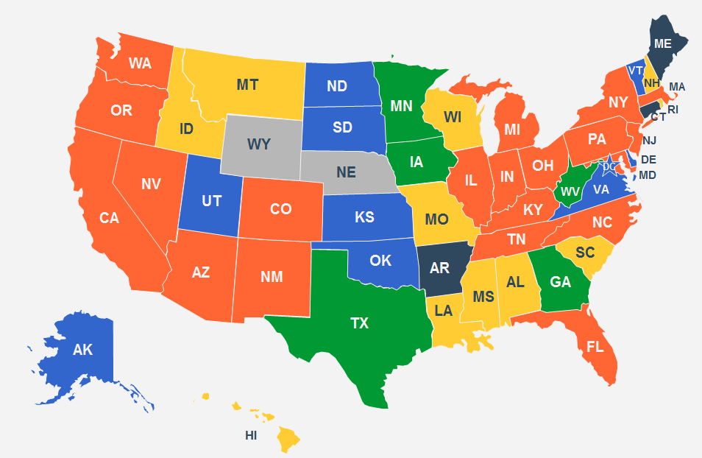
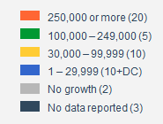
State Government Business
New Medicaid Enrollment Through November 2015
12.6M of 14.1M new CMS-reported¹ Medicaid lives are in HMS customer eligibility files
¹ CMS Medicaid & CHIP: November 2015 Monthly Applications, Eligibility Determinations and Enrollment Report, January 27, 2016. This analysis compares Medicaid enrollment of 14.1 million lives reported through 11/30/15 to enrollment as of 10/1/13, which was the beginning of Marketplace open enrollment and the CMS baseline for measuring expansion
HMSY Q4 2015 Investor Presentation/ February 26, 2016

Slide 13
State Government Business
2015 State TPL Reprocurement Summary
Florida – New five year contract award received in June ‘15 for 9/1/15 start (plus option to renew for up to five additional years)
Illinois – award to another bidder in August ’15, January ‘16 denial of HMS protest appealed
Kansas proposal submitted in January ‘15 – current contract¹ expires 6/30/17
Massachusetts extended for 21 months in March ‘15 – until 12/31/16
New Jersey – award to another bidder in July ’15, protest filed on 2/12/16 and current contract extended to 2/29/16
New Mexico – new one year contract award received in June ‘15 for 12/15/15 start (plus three one-year renewal options)
New York – New five year contract award received in August ‘15 ² (plus two one-year renewal options) - current contract extended to 4/6/16
Oklahoma – new one year contract award received in May ‘15 for 7/1/15 start (plus five one year renewal options)
Tennessee - new three-year contract award received in November ‘15 for 2/1/16 start (plus two one-year renewal options)
Washington – contract extended for one year in June ‘15 - until 6/30/16
Wisconsin – contract extended for one year in June ‘15 - until 6/30/16
¹ HMS is a subcontractor to HP Enterprise Services
² Award is being protested by another bidder
HMSY Q4 2015 Investor Presentation / February 26, 2016

Slide 14
Capital Allocation
Share Repurchases
11
$75 million share repurchase program authorized by HMS Board of Directors in July 2015
Open market or privately negotiated transactions authorized for up to two years
$25 million of shares purchased in 4Q¹, pursuant to 10b5 -1 program
4Q operating cash flow of $30.3 million
Cash balance of $145.6 million on December 31, 2015
Total shares outstanding at year end were 4.5% lower than year end 2014²
Strong Cash Flow Supports Share Repurchase and Potential Acquisitions
Data as of December 31, 2015
¹ 2,095,376 shares repurchased at an average price of $11.91 per share in 4Q’15
² Total share repurchases of 4,747,441 during 2015 at an average price of $10.51 per share;
outstanding share count at 12/31/15 was 83,989,715 compared to 87,985,139 at 12/31/14
HMSY Q4 2015 Investor Presentation / February 26, 2016

Slide 15
2016 Guidance
Summary of Projected Financial Metrics for 2016
YOY Commercial health plan revenue growth of 18-20%
YOY State Medicaid growth flat up to 2%¹ excluding NJ
Medicare RAC revenue of $8 million²
Federal and other revenue of ~$23.5 million³
Flat operating costs (excluding non-recurring legal), while continuing to invest in commercial growth and innovation
Full year projected effective tax rate of approximately 40%
Operating cash flow of $20-25 million per quarter
Full year capital expenses of ~$20 million, primarily for IT infrastructure and product development
¹ Affordable Care Act spillover benefit of estimated [$6-8] million will not be repeated in 2016
² Assumes Medicare RAC revenue of ~$8 million through July 31, 2015 expiration of current contract
³ Federal and other revenue was $24.5 million in 2015
HMSY Q4 2015 Investor Presentation / February 26, 2016

Slide 16
2016 Guidance
13
Key Strategic Themes for 2016
Execution – implementing sold business and delighting our customers with excellent service
Innovation – to stay ahead of the competition and create new product sale opportunities
Efficiency and cost reduction – ongoing product engineering to boost product yield
Maximizing commercial health plan growth – sales to new customers and additional product sales to members within existing customer base
Inorganic growth – making acquisitions to complement a core competency or expand capacity
HMSY Q4 2015 Investor Presentation / February 26, 2016

